Slide 1
Entity-Relationship Query over Wikipedia
International Workshop on Search and Mining User-Generated Contents
@ International Conference on Information and Knowledge Management
Toronto, Ontario, Canada, 2010
Xiaonan Li ¹, Chengkai Li ¹, Cong Yu ²
¹ University of Texas at Arlington
² Yahoo! Research
Notes:
Hello everybody. My name is Xiaonan Li. I am going to introduce our Entity Relationship query over Wikipedia.

Slide 2
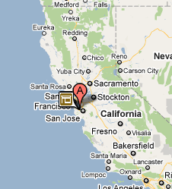

Motivation
A business analyst is investigating the development of Silicon Valley. She is looking for:
Silicon Valley Companies founded by Stanford graduates
Yahoo!
Jerry Yang
Yahoo!
David Filo
Google
Larry Page
HP
David Packard
Notes:
Consider a business analyst, who is investing the development of Silicon Valley. She is looking
“silicon valley companies founded by stanford graduates”. She expect to see answers like Yahoo With Jerry Yang, and Google with Larry Page.

Slide 3
Pain with Search Engine
Search
stanford graduate
Search
silicon valley company
pages
pages
page reading
Paypal
HP
Yahoo!
Google
...
Larry Page
Jerry Yang
Dick Price
David Filo
...
Search
found
pages
<Jerry Yang, Yahoo!> confirmed as a right answer
Notes:
Using a search engine, she may start a search with keywords “stanford” and “graduate”. By reading the returned pages, she will find persons like,... We all know they graduated from Stanford. Then, she will search with keywords “silicon valley company” and find Companies such as....
To see whether Jerry Yang founded Yahoo. She will search with their names as keywords together with keyword “found”. By reading the query results, she can confirm it to be a right answer. However, In the worst case, she has to try a series of searches for all possible combinations of Person and Company.
Apparently, the analyst may easily get frustrated by the potentially large amounts of searches and page readings. She need a more powerful query mechanism to specify the complex information need.

Slide 4
Entity-Relationship Query
Search
stanford graduate
Search
silicon valley company
Entity Variable
(with type constraints)
SELECT x
FROM PERSON AS x
Entity-Centric
Declarative
Structured
Keyword-based
, y
, COMPANY AS y
WHERE x:[“stanford” “graduate”] ... p1
AND y:[“silicon valley”] ........ p2
AND x,y:[“found”] ............... p3
Relation Predicate
(2 or more variables)
Selection Predicate
(one variable)
Search
Jerry Yang found Yahoo
Notes:
In answer to this call, we propose ERQ. Let's take the search for Stanford graduates as an example.
The corresponding ERQ contains entity variable x which belongs to type Person. The selection predicate P1 says, only Persons co-occurring with keywords stanford and graduate are wanted.
For the search of Silicon Valley companies, we can add another variable y of type Company, with a corresponding selection predicate p2.
Further, we use a relation predicate to specify the relationship between x and y with keyword “found”.
This new type of query is ...

Slide 5
Query Answer
<x:Jerry Yang, y:Yahoo!> is a query answer, if
x:[“Stanford” “graduate”] ... p1
Stanford University graduates Jerry Yang and …
y:[“Silicon Valley”] ........ p2
… a senior manager at Yahoo! in Silicon Valley.
x,y:[“found”] ............... p3
Jerry Yang co-founded Yahoo!.
co-occurrence contexts as evidence
Notes:
Given this query, We say <Jerry Yang ,Yahoo> is a query answer if we can find evidence for all three predicates.
For example, the evidence for predicate p1 is a context in which Jerry Yang co-occurs with keywords “stanford” and “graduate”

Slide 6
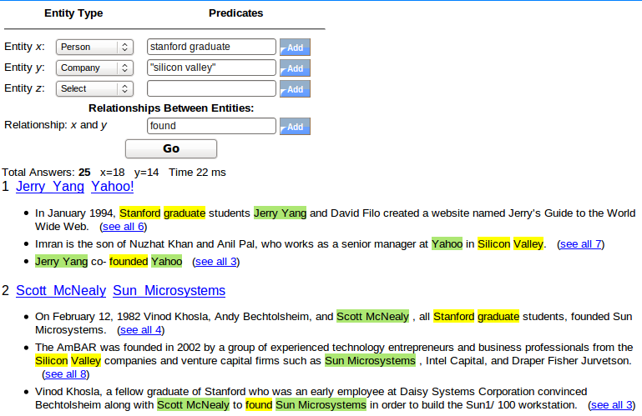
Type in the query
Browse the answers
Notes:
Now, with this query facility, the analyst can simply type in the query and browse the answers.
However, there can be many accidental co-occurrences that lead to false answers. The ranking of answers has a big impact of user satisfaction

Slide 7
Ranking
0.8 * 0.7 * 0.8 = 0.448
answer | x | y | p1 | p2 | p3 | Ranking score
t1 | Jerry Yang | Yahoo! | 0.8 | 0.7 | 0.8 | 0.448
t2 | Larry Page | Google | 0.6 | 0.5 | 0.6 | 0.180
t3 | Scott McNealy | Cisco | 0.9 | 0.8 | 0.2 | 0.144
t4 | Bill Gates | IKEA | 0.3 | 0.1 | 0.2 | 0.006
The predicate score is aggregated from contexts / evidence
Notes:
Here is a sample list of answers to our example query, including <Jerry Yang, Yahoo> <Larry Page, Google> and false answers like <Bill Gates, IKEA> For each answer, we compute three predicate scores and aggregate them into the ranking score.
Each individual predicate score is aggregated from evidence contexts. And there are many ways to do that.

Slide 8
Predicate Scoring
Baseline 1 [COUNT]: number of co-occurrence contexts
However, contexts are different from each other.
We exploit positional features for refined evaluation of contexts.
proximity
ordering pattern
mutual exclusion
Notes:
A naïve baseline computes the predicate score as the number of supporting contexts. Answers with more contexts are scored higer.
However, contexts are different from each other, and we may want to differentiate their reliability.
In our approach, we exploit three positional features to evaluate contexts, namely ....
We will introduce them in the next few slides

Slide 9
Feature 1: Proximity
x:[“Stanford” “graduate”] ... p1
s1: Stanford University graduates Jerry Yang and …
prox(Jerry Yang, s1) = ( 1 + 1 + 2 ) / 5 = 0.8
Higher proximity indicates more reliable evidence
Baseline 2 [PROX]: weight each contexts by proximity
Notes:
Given the context s1 for the first predicate, the proximity score of Jerry Yang in this context can be calculated as such.
Based on empirical observation, we can reasonably assume that higher proximity indicates more reliable evidence.
Hence, our second baseline weights each contexts by proximity score.

Slide 10
Feature 2: Ordering Pattern
f(sgx)=(4+2)/(4+2+3)=0.67
f(sxg)=(3)/(4+2+3)=0.33
x~PERSON, s~Stanford, g~graduate
6 patterns: xsg,xgs, sxg, gxs, sgx, gsx
Stanford University graduates Jerry Yang and … (4 times)
… Stanford graduates Larry Page … (2 times)
Frequent patterns indicate reliable evidence.
A professor at Stanford University, Colin Marlow had a relationship with Cristina Yang before she graduated ... (3 times)
Notes:
Now lets use x,s and g to represent PERSON, stanford and gradaute, respectively. There can be 6 ordering patterns among them.
Assume that only 9 contexts for predicate 1 are retrieved for all answers. 6 of them follows pattern “Stanford graduate sb”, and the other 3 follows the pattern “Stanford sb graduate”.
We observe that, frequent patterns usually indicates reliable evidence.

Slide 11
Feature 3: Mutual Exclusion
xgs
s4: After Ric Weiland graduated from Stanford University, Paul Allen and Bill Gates hired him in 1975 ...
gsx
gsx
The most proximate entity
as representative
Patten Entities
xgs Ric Weiland
gsx Paul Allen, Bill Gates
colliding patterns
Assumption: only one of the colliding patterns is effective.
Which one?
Notes:
For mutual exclusion feature, let's take a look at a more complicated context that contains multiple PERSON.
This context has two colliding patterns. Ric Weiland
follows the pattern xgs. Pall Allen and Bill Gates follows the other pattern gsx.
The mutual exclusion rule says that, only one of the
colliding pattern is effective in such a context. But the question is how do we know which one is effective.
Here, we make a special treatment to call the most proximate entity of each colliding pattern as representative of that pattern. In this context, Ric Weiland and Paul Allen are the representatives.

Slide 12
Feature 3: Mutual Exclusion (2)
The pattern represented by more prominent entity (thus higher credit) is more likely to be effective.
s4: After Ric Weiland graduated from Stanford University, Paul Allen and Bill Gates hired him in 1975 ...
# context (Ric Weiland) = 4
# context (Paul Allen) = 2
credit (xgs, s4) = 4 / (4+2) = 0.67
credit (gsx, s4) = 2 / (4+2) = 0.33
Baseline 3 [MEX]: weight each contexts by credit (effectiveness)
(for contexts without collision, the credit(o,s)=1)
Notes:
In our solution, we compare the prominence of the two representatives in this context. Suppose Ric Weiland has 4 contexts in total, Paul Allen has 2. We allocate credits for their corresponding patterns as such.
Our assumption is that the pattern represented by more prominent entity (thus higher credit) is more likely to be effective.
Therefore, our third baseline weights each context by the allocated credit.
You may wonder why we only use representatives for the allocation. The intuition can be explained from this context. Between PA and BG, If Paul Allen is not associated with the keyword “graduate stanford”, then Bill Gates is unlikely to be associated to the keywords, either. So the PA is critical for deciding pattern effectiveness.

Slide 13
Predication Scoring (cont.)
answer | x | y | p1 | p2 | p3 | Ranking score
t1 | Jerry Yang | Yahoo! | 0.8 | 0.7 | 0.8 | 0.448
t2 | Larry Page | Google | 0.6 | 0.5 | 0.6 | 0.180
t3 | Scott McNealy | Cisco | 0.9 | 0.8 | 0.2 | 0.144
t4 | Bill Gates | IKEA | 0.3 | 0.1 | 0.2 | 0.006
Bounded Cumulative Model (BCM): integrating all features
ordering pattern
proximity
mutual exclusion
Notes:
Coming back to this list of sample answers, we propose a Bounded Cumulative Model to compute predicate scores. The model integrates all three features we just introduced.

Slide 14

Experiment: Data Set
Data Set
  2 million Wikipedia articles
  10 predefined types (PERSON, COMPANY, NOVEL, etc.)
  0.75 million entities (a subset of articles)
  100 million entity occurrences (links to entities)
Two Query Sets
  INEX17 – adapted from topics in INEX09 Entity Ranking track
    Single-11, Multi-6
  OWN28 – manually created
    Single-16, Multi-12
Pride and Prejudice
Pride and Prejudice is a novel by Jane Austen. ..
Categories: 1913 novels | British novels

Slide 15
State-of-the-art:
EntityRank(ER) [Cheng et al. VLDB07]
A probabilistic model
Only uses proximity feature (in a different way)
Only handle queries similar to our single-predicate querys
SELECT x
FROM PERSON AS x
WHERE x:[“stanford” “graduate”]
We use it for computing predicate scores in our structured query model

Slide 16
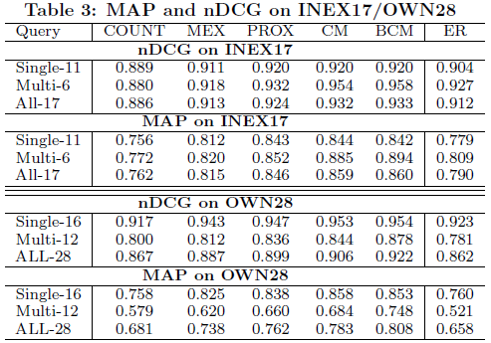
Experiment: Results
(nDCG and MAP)
BCM has the best performance
The advantage even more clear for multi-predicate queries.
single-predicate
queries
multi-predicate
queries
Notes:
We evaluated various ranking methods by
Normalized discounted cumulative gain
and mean average precision, both are popular measures in IR.

Slide 17
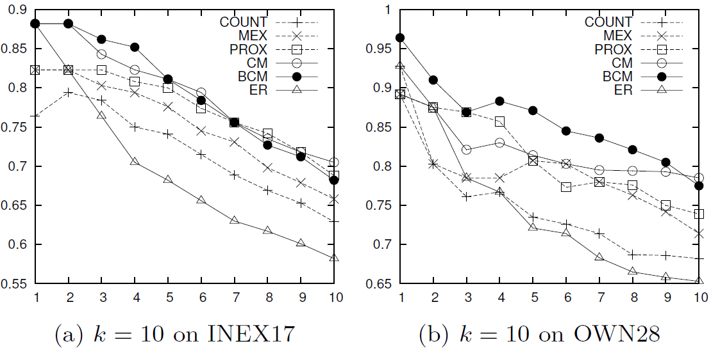
Experiment: Results precition-at-k
BCM is consistently the best
EntityRank is close to BCM at top 2, but degrades quickly
BCM
EntityRank
Notes:
The precision-at-k curves also shows that BCM is consistently the best across different ranking positions. EntityRank is close to BCM at top 2 but degrades quickly afterwards.

Slide 18
Related Work (1)
IE-Based Approach
Pre-extract information into database for query
Still a huge challenge to extract all information
Un-extracted information is lost and unavailable for query
[TextRunner] Etzioni et al. Open information extraction from the Web. Communication ofACM, 51(12):68–74, 2008.
[DBPedia] Auer et al. DBpedia: A nucleus for a Web of open data. In Int.l Semantic Web Conf., 2007.
[Yago] Suchanek. YAGO: a core of semantic knowledge unifying WordNet and Wikipedia. In WWW, 2007.

Slide 19
Related Work (2)
IR-Based Approach
(ERQ belongs to this approach)
Search directly in corpus
All information is pristine and is available for query
ProxSearch and EntityRank only handle queries resembling our single-predicate query
CSAW focuses on HTML tables
[ProxSearch] Chakrabarti et al. Optimizing scoring functions and indexes for proximity search in type-annotated corpora. In WWW, 2006.
[EntityRank] Cheng et al. EntityRank: searching entities directly and holistically. VLDB 2007.
[CSAW] Limaye et al. Annotating and Searching Web Tables Using Entities, Types and Relationships. VLDB 2010.
Notes:
ERQ belongs to the IR-based approach. Which searches directly in annotated corpus. Therefore, all information are pretine and available for query.
However, as we mentioned before, existing systems ...

Slide 20
Demo http://idir.uta.edu/erq

